Slide 1
Virtual Memory
Course Instructor: Nausheen Shoaib

Slide 2
Definition of Virtual Memory [1/2]
Virtual memory is a memory management capability of an OS
uses hardware and software to allow a computer to compensate for physical memory shortages by temporarily transferring data from random access memory (RAM) to disk storage.

Slide 3
Definition of Virtual Memory [2/2]
VIrtual memory is not RAM (Random access memory) on memory chips.
Virtual memory is an area of hard drive or other storage space, which OS uses as swap space (overflow) for the physical RAM. When the demands of the software and data exceed the physical RAM size, the operating system copies to hard disk blocks of data from RAM that have been seldom used, and releases that RAM for use by the current process.
When the block (or Page) is required again, the OS makes room in RAM by copying another block to hard drive and copying in the data from the first block.

Slide 4
Background
Virtual memory – separation of user logical memory from physical memory
Only part of the program needs to be in memory for execution
Logical address space can therefore be much larger than physical address space
Allows address spaces to be shared by several processes
Allows for more efficient process creation
More programs running concurrently
Less I/O needed to load or swap processes
Virtual memory can be implemented via:
Demand paging
Demand segmentation

Slide 5
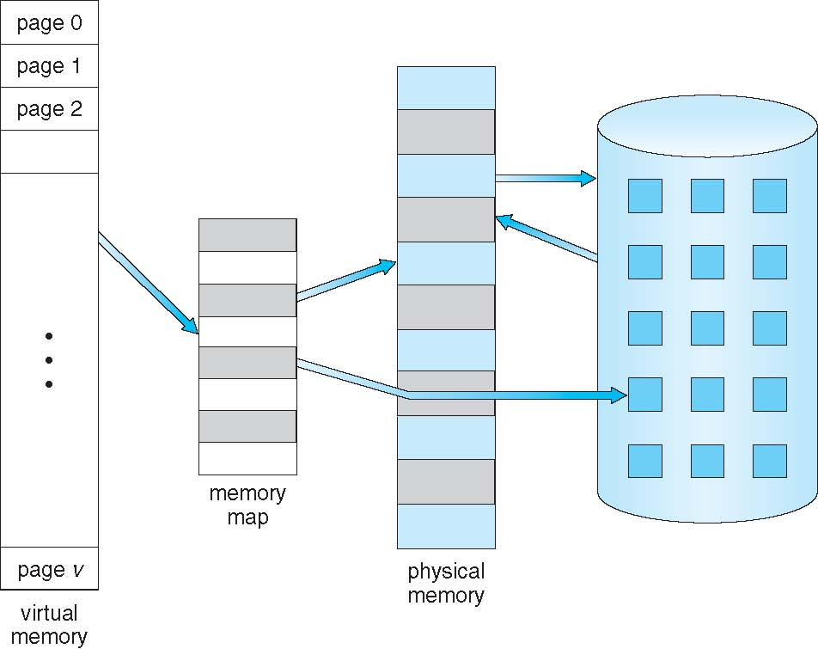
Virtual Memory That is Larger Than Physical Memory

Slide 6
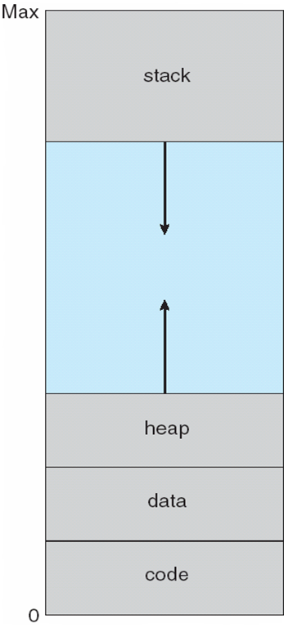
Virtual-address Space

Slide 7
Virtual Address Space
Virtual address spaces that include holes are known as sparse address spaces.
System libraries shared via mapping into virtual address space
Shared memory by mapping pages read-write into virtual address space
Pages can be shared during fork(), speeding process creation

Slide 8
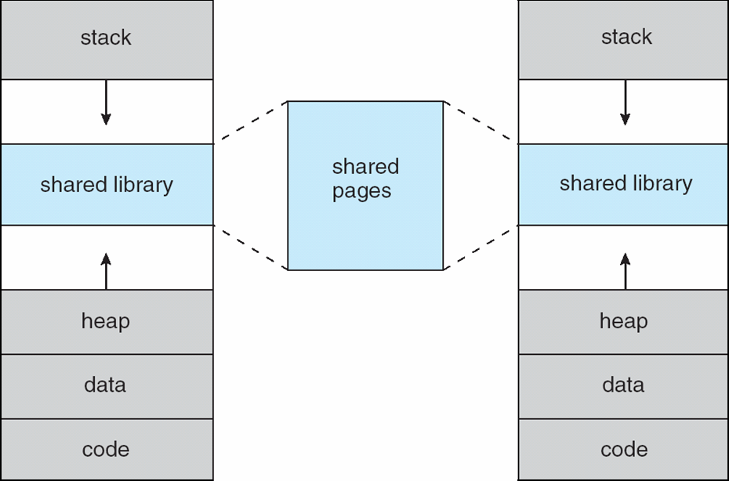
Shared Library Using Virtual Memory

Slide 9
Demand Paging
Could bring entire process into memory at load time
Or bring a page into memory only when it is needed
Less I/O needed, no unnecessary I/O
Less memory needed
Faster response
More users
Page is needed ⇒ reference to it
invalid reference ⇒ abort
not-in-memory ⇒ bring to memory
Lazy swapper – never swaps a page into memory unless page will be needed
Swapper that deals with pages is a pager

Slide 10
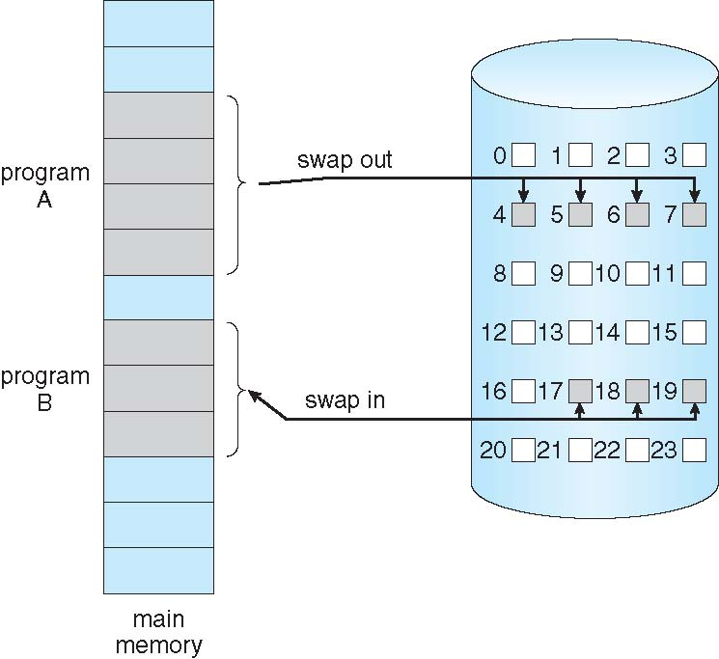
Transfer of a Paged Memory to Contiguous Disk Space

Slide 11
Valid-Invalid Bit
With each page table entry a valid–invalid bit is associated (v ⇒ in-memory – memory resident, i ⇒ not-in-memory)
Initially valid–invalid bit is set to i on all entries
Example of a page table snapshot:
During address translation, if valid–invalid bit in page table entry is I ⇒ page fault
Frame #
valid-invalid bit
v
v
v
i
….
page table
i
i

Slide 12
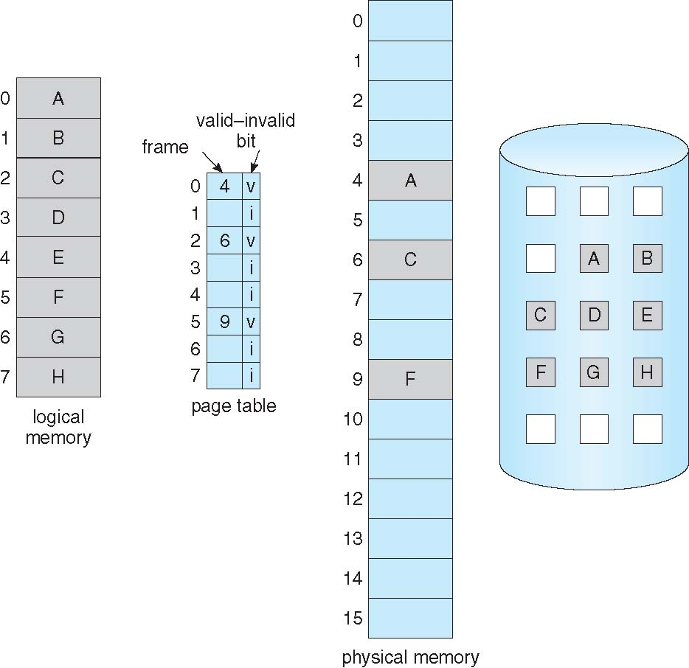
Page Table When Some Pages Are Not in Main Memory

Slide 13
Page Fault
If there is a reference to a page, first reference to that page will trap to operating system:
page fault
Operating system looks at another table to decide:
Invalid reference ⇒ abort
Just not in memory
Get empty frame
Swap page into frame via scheduled disk operation
Reset tables to indicate page now in memory Set validation bit = v
Restart the instruction that caused the page fault

Slide 14
Aspects of Demand Paging
Extreme case – start process with no pages in memory
OS sets instruction pointer to first instruction of process, non-memory-resident -> page fault
And for every other process pages on first access
Pure demand paging
Actually, a given instruction could access multiple pages -> multiple page faults
Pain decreased because of locality of reference
Hardware support needed for demand paging
Page table with valid / invalid bit
Secondary memory (swap device with swap space)
Instruction restart

Slide 15
Instruction Restart
Consider an instruction that could access several different locations
block move
auto increment/decrement location
Restart the whole operation

Slide 16
Steps in Handling a Page Fault
1. We check an internal table (usually kept with PCB) for
this process to determine whether the reference was a valid or an invalid
memory access.
2. If the reference was invalid, we terminate the process. If it was valid but
we have not yet brought in that page, we now page it in.
3. We find a free frame (by taking one from the free-frame list, for example).
4. We schedule a disk operation to read the desired page into the newly
allocated frame.
5. When the disk read is complete, we modify the internal table kept with
the process and the page table to indicate that the page is now in memory.
6. We restart the instruction that was interrupted by the trap. The process
can now access the page as though it had always been in memory.

Slide 17
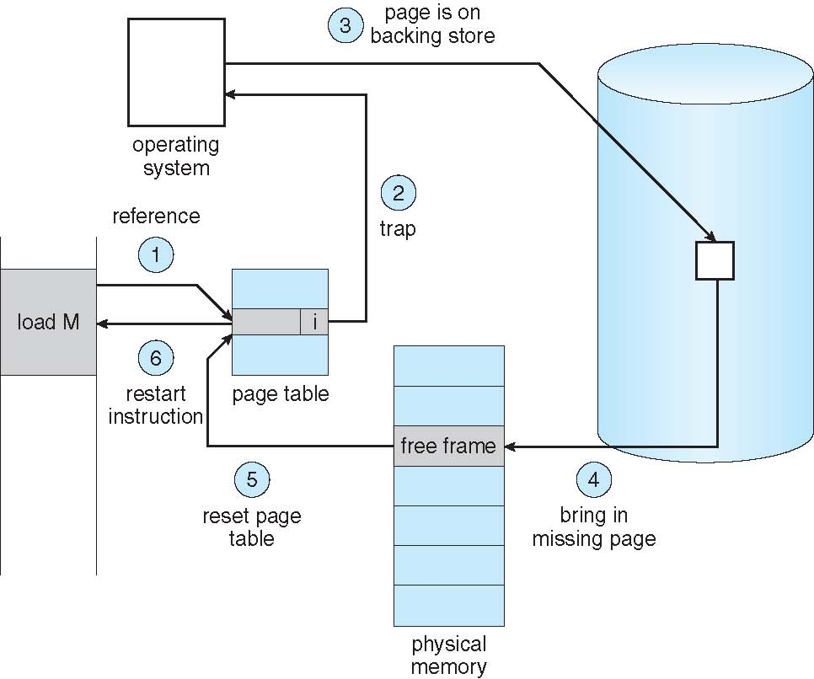
Steps in Handling a Page Fault

Slide 18
Performance of Demand Paging
Stages in Demand Paging
Trap to the operating system
Save the user registers and process state
Determine that the interrupt was a page fault
Check that the page reference was legal and determine the location of the page on the disk
Issue a read from the disk to a free frame:
Wait in a queue for this device until the read request is serviced
Wait for the device seek and/or latency time
Begin the transfer of the page to a free frame
While waiting, allocate the CPU to some other user
Receive an interrupt from the disk I/O subsystem (I/O completed)
Save the registers and process state for the other user
Determine that the interrupt was from the disk
Correct the page table and other tables to show page is now in memory
Wait for the CPU to be allocated to this process again
Restore the user registers, process state, and new page table, and then resume the interrupted instruction

Slide 19
Performance of Demand Paging (Cont.)
Page Fault Rate 0 ≤ p ≤ 1
if p = 0 no page faults
if p = 1, every reference is a fault
Effective Access Time (EAT)
effective access time = (1 − p) × ma + p × page fault time.

Slide 20
Performance of Demand Paging (Cont.)
Memory Access Time = 200 nanoseconds
Average page fault service time = 8 millisecond
If one access out of 1,000 causes a page fault, then p=1/1000=0.001
effective access time = (1 − p) × ma + p × page fault time.
EAT= (1-0.001)*200+(0.001* 8e6)
= 8199.8 nanosecond
= 8.199 microsecond
Millisecond = 10e-3
Microsecond =10e-6
Nanosecond = 10e-9

Slide 21
Demand Paging Optimizations
Copy entire process image to swap space at process load time
Then page in and out of swap space
Used in older BSD Unix
Demand page in from program binary on disk, but discard rather than paging out when freeing frame
Used in Solaris and current BSD

Slide 22
Copy-on-Write
Copy-on-Write (COW) allows both parent and child processes to initially share the same pages in memory
If either process modifies a shared page, only then is the page copied
COW allows more efficient process creation as only modified pages are copied
In general, free pages are allocated from a pool of zero-fill-on-demand pages
vfork() variation on fork() system call has parent suspend and child using copy-on-write address space of parent
Designed to have child call exec()
Very efficient

Slide 23
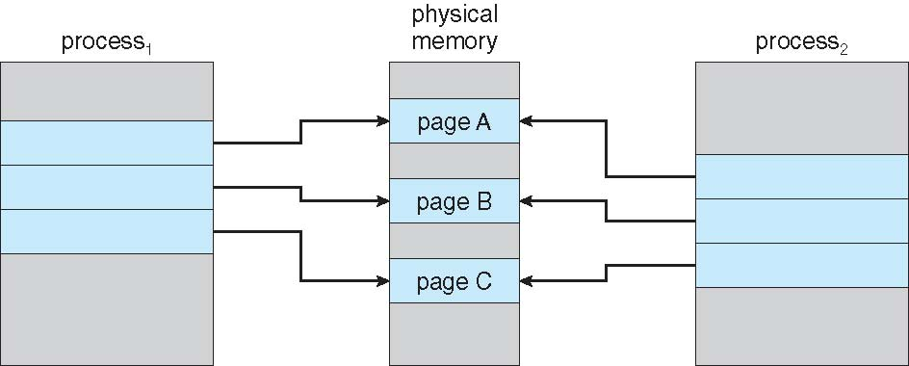
Before Process 1 Modifies Page C

Slide 24
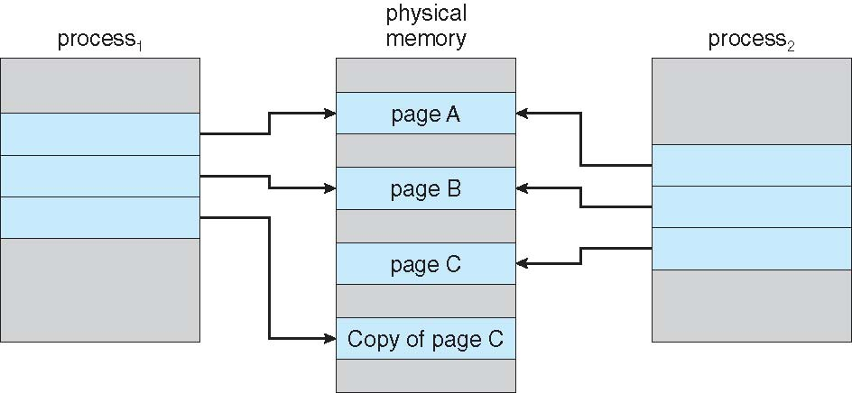
After Process 1 Modifies Page C

Slide 25
What Happens if There is no Free Frame?
Used up by process pages
Also in demand from the kernel, I/O buffers, etc
How much to allocate to each?
Page replacement – find some page in memory, but not really in use, page it out
Algorithm – terminate? swap out? replace the page?
Performance – want an algorithm which will result in minimum number of page faults
Same page may be brought into memory several times

Slide 26
Page Replacement
Prevent over-allocation of memory by modifying page-fault service routine to include page replacement
Use modify (dirty) bit to reduce overhead of page transfers – only modified pages are written to disk
Page replacement completes separation between logical memory and physical memory – large virtual memory can be provided on a smaller physical memory

Slide 27
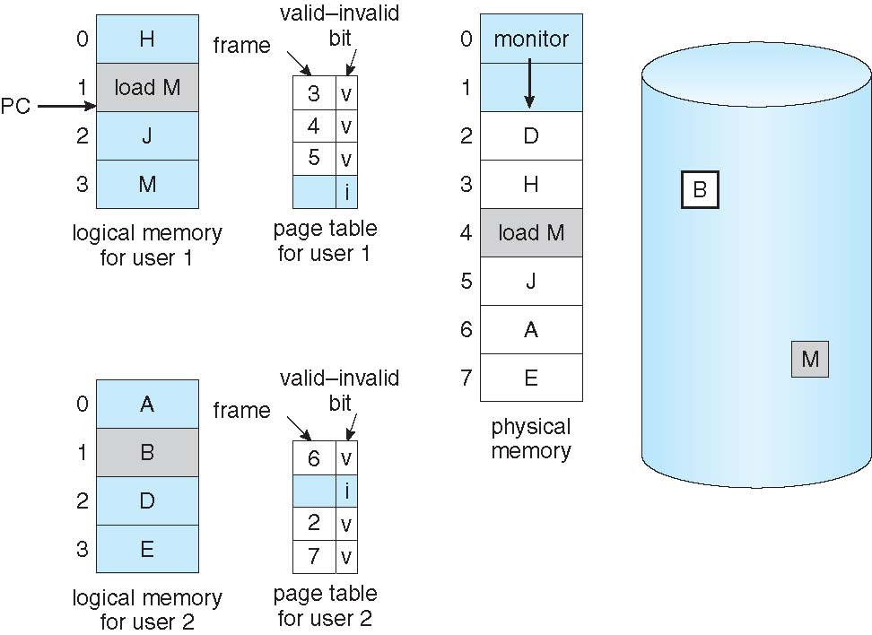
Need For Page Replacement

Slide 28
Basic Page Replacement
Find the location of the desired page on disk
Find a free frame: - If there is a free frame, use it - If there is no free frame, use a page replacement algorithm to select a victim frame - Write victim frame to disk if dirty
Bring the desired page into the (newly) free frame; update the page and frame tables
Continue the process by restarting the instruction that caused the trap
Note now potentially 2 page transfers for page fault – increasing EAT

Slide 29
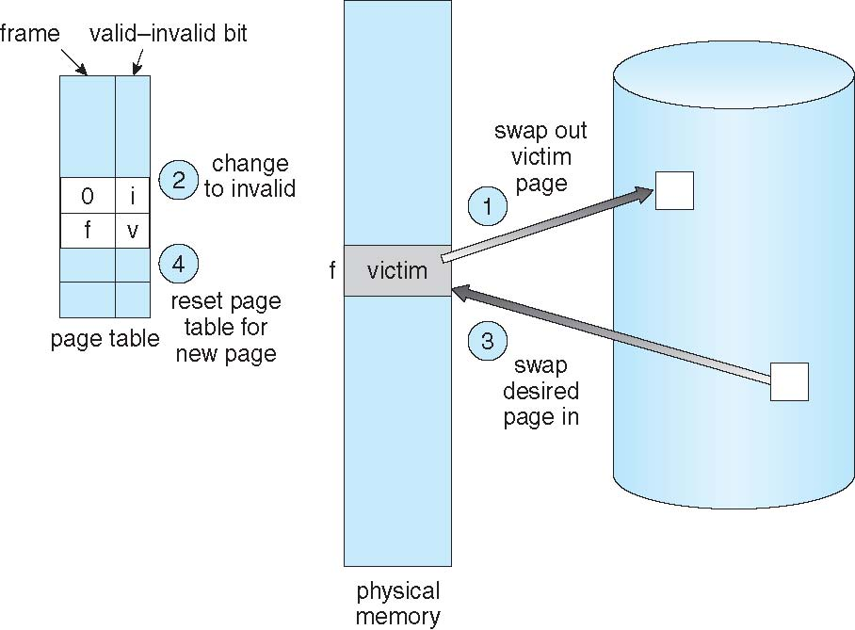
Page Replacement

Slide 30
Page and Frame Replacement Algorithms
Frame-allocation algorithm determines
How many frames to give each process
Which frames to replace
Page-replacement algorithm
Want lowest page-fault rate on both first access and re-access

Slide 31
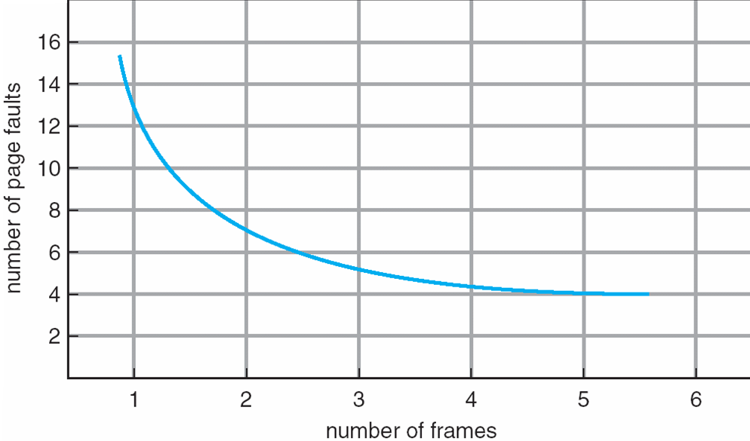
Graph of Page Faults Versus The Number of Frames

Slide 32
First-In-First-Out (FIFO) Algorithm
Reference string: 7,0,1,2,0,3,0,4,2,3,0,3,0,3,2,1,2,0,1,7,0,1
3 frames (3 pages can be in memory at a time per process)
Can vary by reference string: consider 1,2,3,4,1,2,5,1,2,3,4,5
Adding more frames can cause more page faults!
Belady’s Anomaly
How to track ages of pages?
Just use a FIFO queue
1
7
2
4 0 7
2
0
3
15 page faults
2 1 0
3
1
0
3 2 1

Slide 33
FIFO Page Replacement Example
Covered in Class

Slide 34
Optimal Algorithm
Replace page that will not be used for longest period of time
9 is optimal for the example on the next slide

Slide 35
Optimal Page Replacement Example
Covered in Class

Slide 36
Least Recently Used (LRU) Algorithm
Use past knowledge rather than future
Replace page that has not been used in the most amount of time
Associate time of last use with each page

Slide 37
LRU Algorithm (Cont.)
Counter implementation
Every page entry has a counter; every time page is referenced through this entry, copy the clock into the counter
When a page needs to be changed, look at the counters to find smallest value
Search through table needed
Stack implementation
Keep a stack of page numbers in a double link form:
Page referenced:
move it to the top
requires 6 pointers to be changed
But each update more expensive
No search for replacement

Slide 38
LRU Algorithm Example
Covered in Class

Slide 39
LRU Approximation Algorithms
LRU needs special hardware and still slow
Reference bit
With each page associate a bit, initially = 0
When page is referenced bit set to 1
Replace any with reference bit = 0 (if one exists)
We do not know the order, however
Second-chance algorithm
Generally FIFO, plus hardware-provided reference bit
Clock replacement
If page to be replaced has
Reference bit = 0 -> replace it
reference bit = 1 then:
set reference bit 0, leave page in memory
replace next page, subject to same rules

Slide 40
Second Chance Algorithm
Covered in Class

Slide 41
Counting Algorithms
Keep a counter of the number of references that have been made to each page
Not common
LFU Algorithm: replaces page with smallest count
MFU Algorithm: based on the argument that the page with the smallest count was probably just brought in and has yet to be used

Slide 42
Page-Buffering Algorithms
Keep a pool of free frames, always
Then frame available when needed, not found at fault time
Read page into free frame and select victim to evict and add to free pool
When convenient, evict victim
Possibly, keep list of modified pages
When backing store otherwise idle, write pages there and set to non-dirty
Possibly, keep free frame contents intact and note what is in them
If referenced again before reused, no need to load contents again from disk
Generally useful to reduce penalty if wrong victim frame selected

Slide 43
Applications and Page Replacement
All of these algorithms have OS guessing about future page access
Some applications have better knowledge – i.e. databases
Memory intensive applications can cause double buffering
OS keeps copy of page in memory as I/O buffer
Application keeps page in memory for its own work
Operating system can given direct access to the disk, getting out of the way of the applications
Raw disk mode
Bypasses buffering, locking, etc

